Slide 1

Enhancing Automated Driving Systems Through Advanced Testing and Validation"
Presented by:
Sudip Kishan Sarker(P44000039)
Niloy Saha(P44000040) Md Enamul Hasan Sobuj (P44000060)
Under the supervision of
Prof. LUIGI PARIOTA
Prof. ANGELO COPPOLA
2

Slide 2
Aim of the project
Main Aim: To rigorously evaluate and optimize automated driving systems under varied operational settings ensuring adaptability and robust performance.
Specific Objectives:
Dynamic System Parametrization:
Investigate the impact of dynamic parametrization on control system performance, adjusting key variables such as vehicle mass, time gap, and standstill distance.
Testing Under Uncertainty:
Examine the system’s response to uncertainties, including variations in communication delays gauge its reliability and safety.
NOTE: This project employs a comprehensive simulation approach using advanced tools like MATLAB/Simulink and SUMO to create realistic traffic scenarios, enabling us to pinpoint and address potential vulnerabilities in automated driving systems.

Slide 3
Integrating SUMO (TraCI) for Enhanced Simulation Realism
To simulate realistic traffic conditions and dynamic environments, our project utilizes SUMO (Simulation of Urban MObility) coupled with the TraCI (Traffic Control Interface).
Why Use SUMO (TraCI)?
Facilitates the testing of automated vehicles in complex, changing traffic scenarios not easily replicable in controlled environments.
Enables the integration of vehicular control algorithms with real-world traffic data, enhancing the validation of system adaptability and response accuracy.
Applications in Our Project:
SUMO is integrated within our MATLAB/Simulink simulation environment to create detailed and variable traffic scenarios that our automated driving systems must navigate.
TraCI is used to dynamically alter traffic conditions and vehicle parameters during simulations, testing the system’s adaptability to sudden changes such as varying speeds, different vehicle densities.

Slide 4
Sampling in Example 1 - LHS Methodology
Introduction to LHS: Latin Hypercube Sampling (LHS) is a statistical method used to generate a sample of possible collections of parameter values from a multidimensional distribution. It is designed to ensure that the entire range of each parameter is explored efficiently.
Implementation Details: In Example 1, LHS is employed to systematically explore variations in critical vehicle dynamics parameters—mass, time gap, standstill distance, and communication delay. This ensures that each parameter is sampled across its entire range, avoiding clustering and providing a robust dataset for simulations.
Number of Simulations: Model A: 200 Model B: 300

Slide 5
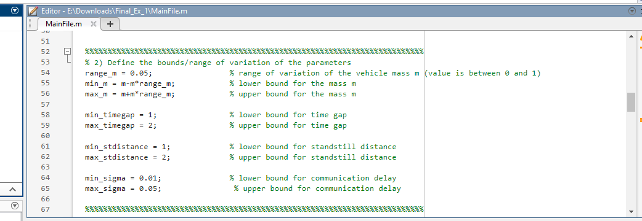
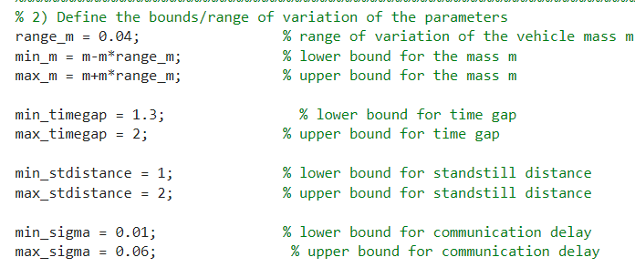
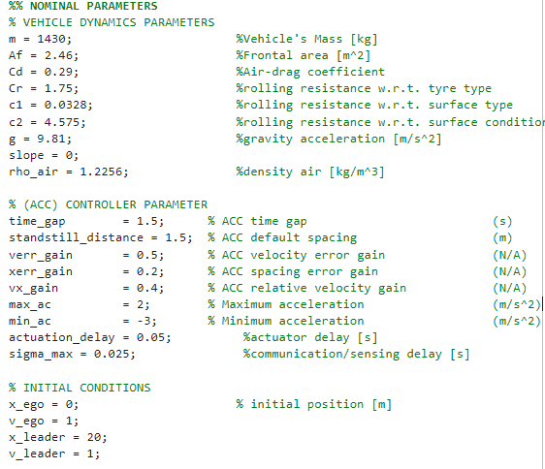
Example 1:
Model A: Given Parameters
Model B: Changed the variables considered and varied their variation ranges
A
B
Changed Parameter Range

Slide 6
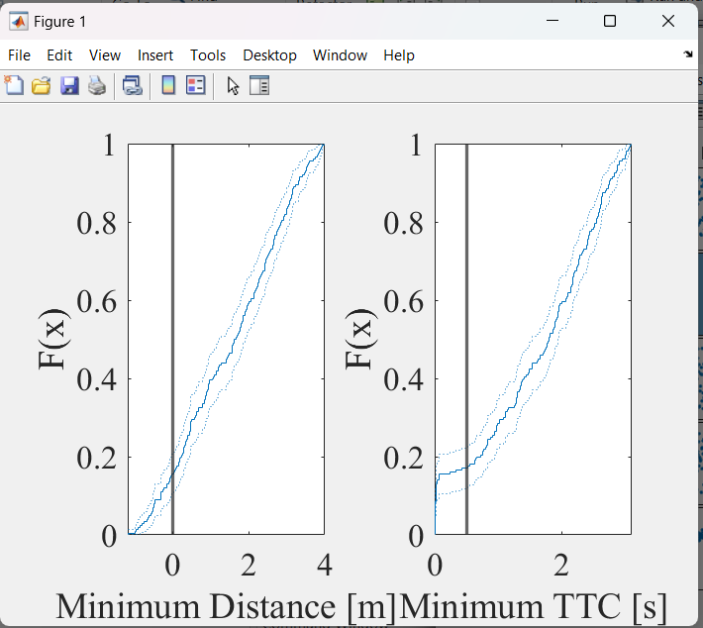
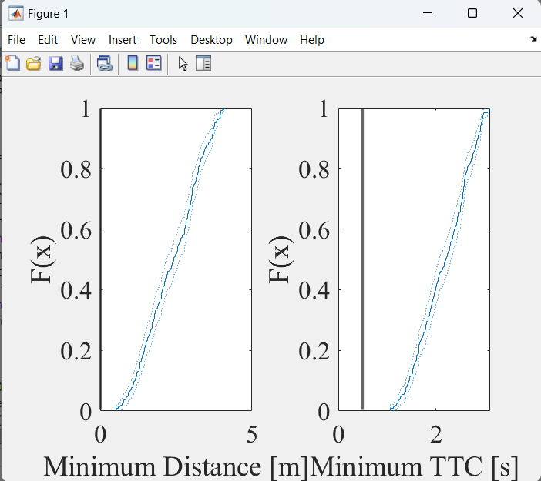
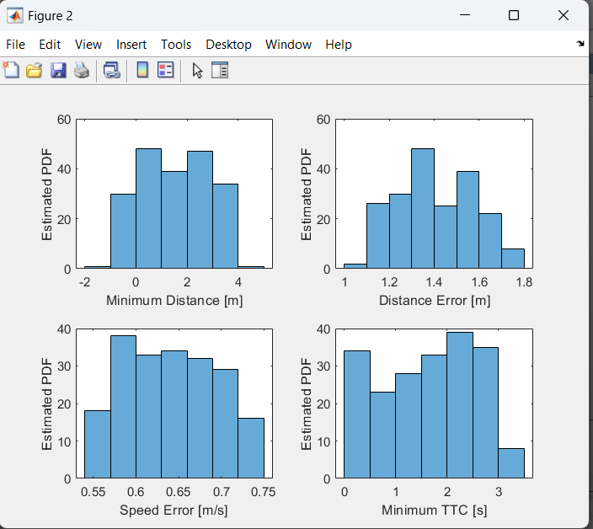
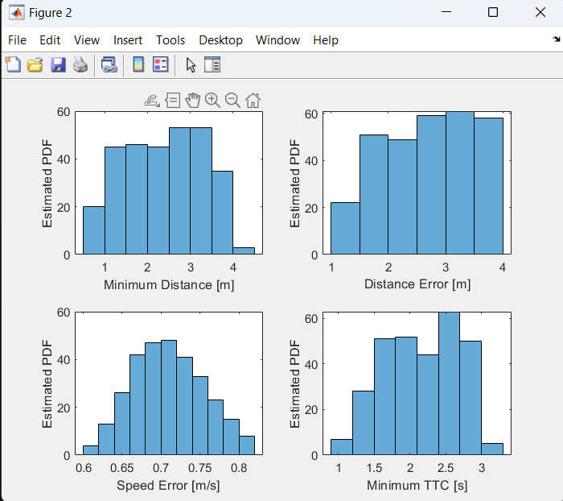
Data Analysis
A
B

Slide 7
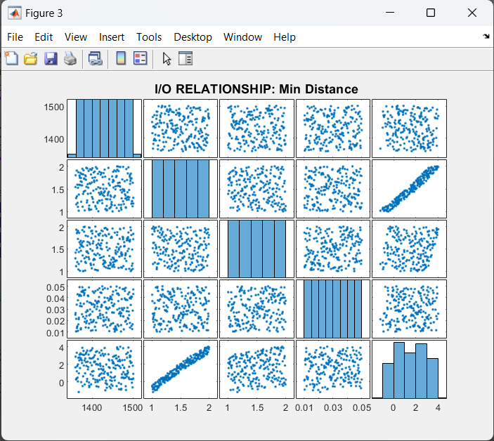
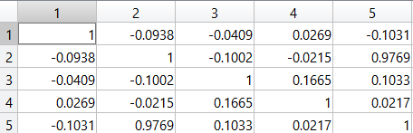
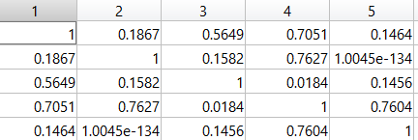
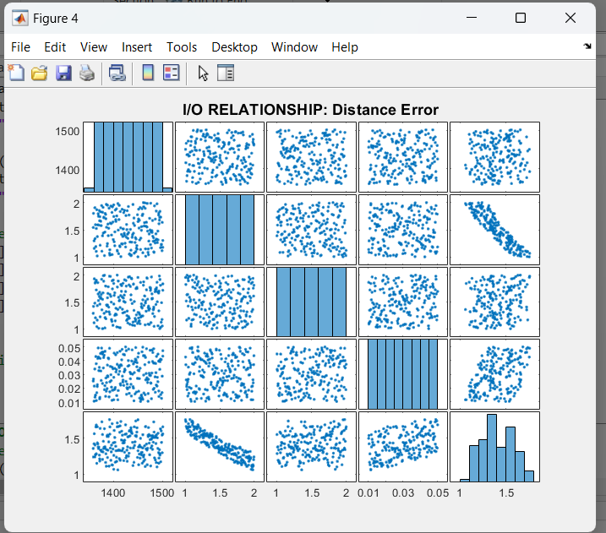
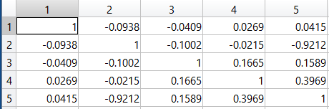
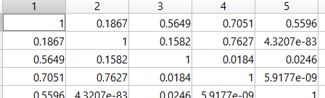
Correlation of the Min Distance and Distance error
Model B
Correlation Analysis
R1
P1
R1
P2

Slide 8
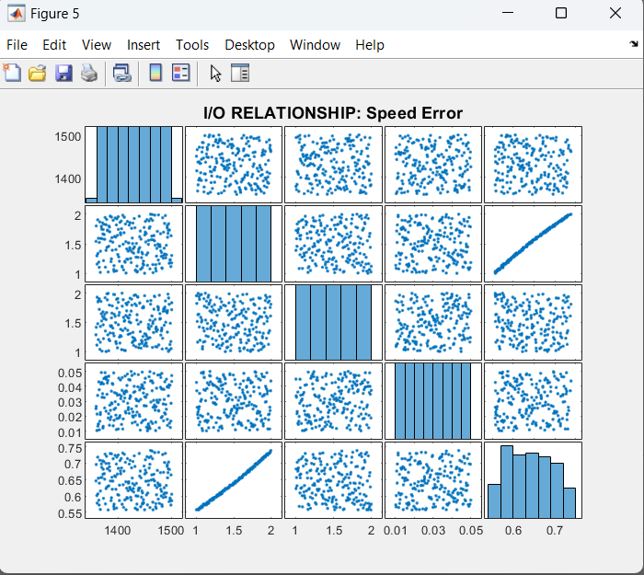
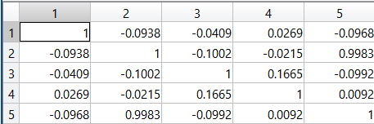
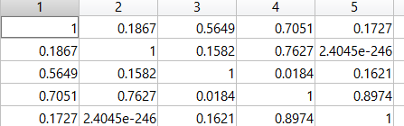
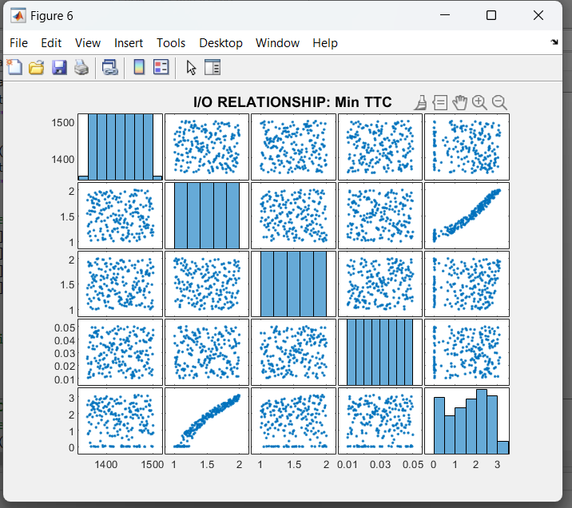
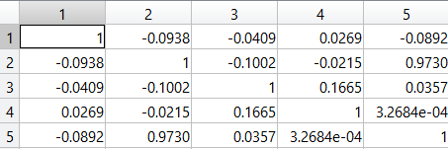
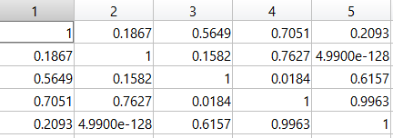
Correlation of the Speed Error and Min TTC
Model B
Correlation Analysis
R3
P3
R4
P4

Slide 9
Sampling in Example 1 - LHS Methodology
Purpose of Using LHS: The use of LHS allows for capturing a comprehensive and evenly distributed set of scenarios, enhancing the predictive power and reliability of our simulation outcomes. This method is particularly crucial given the high-dimensional nature of our parameter space.
Outcome: The application of LHS in Code 1 has enabled efficient and effective assessment of automated vehicle behaviors under a wide array of operational conditions, leading to valuable insights into system performance and safety margins.“

Slide 10
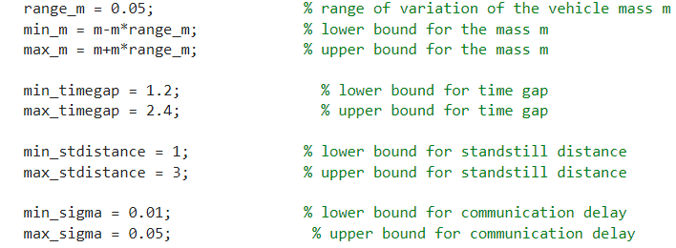
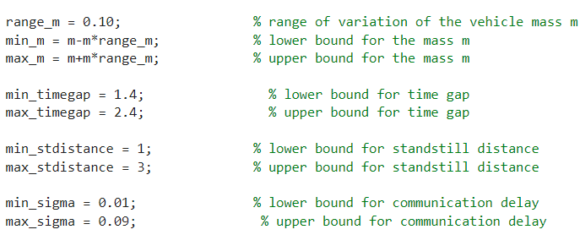
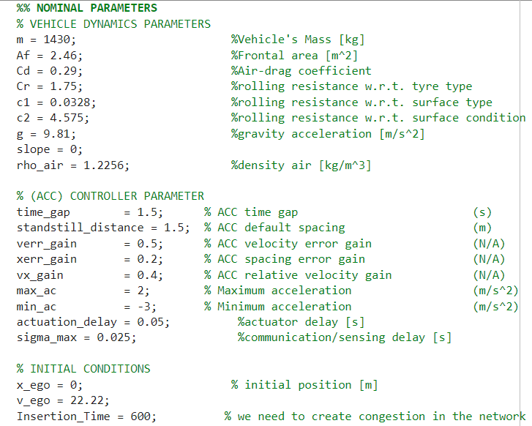
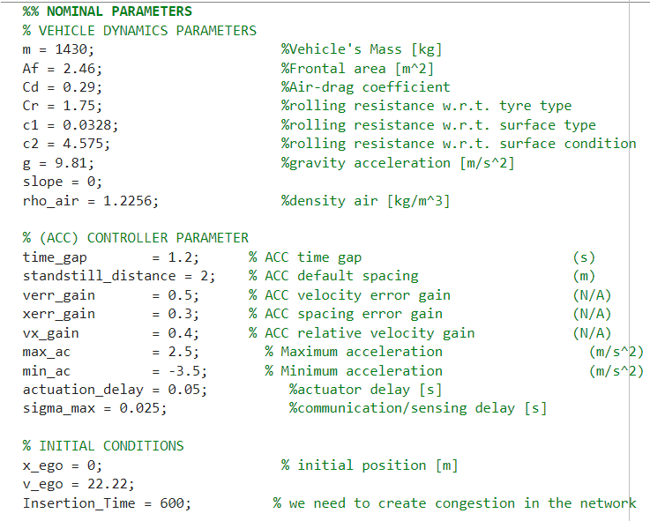
Example 2:
A
B

Slide 11
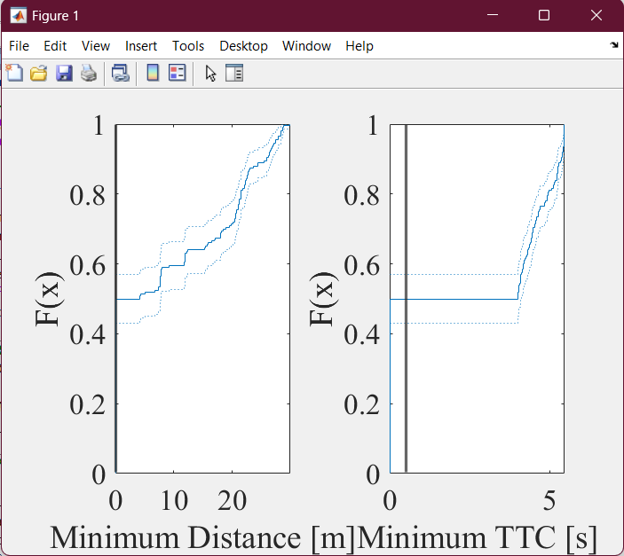
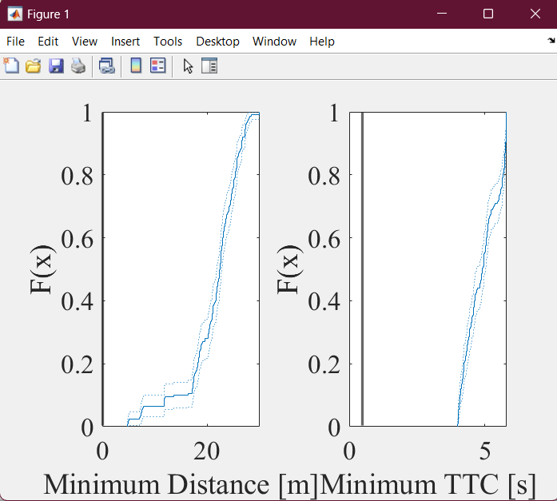
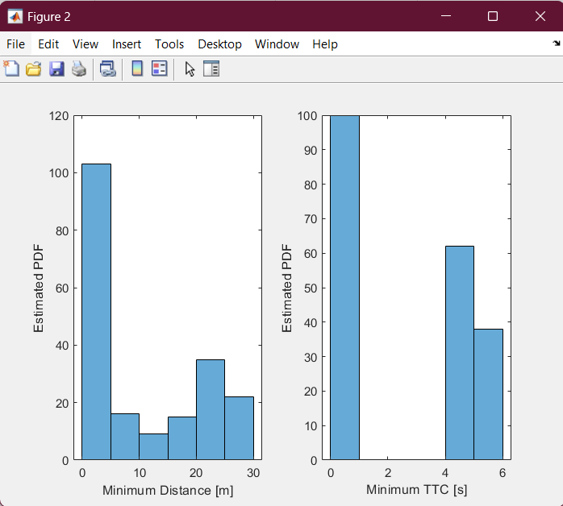
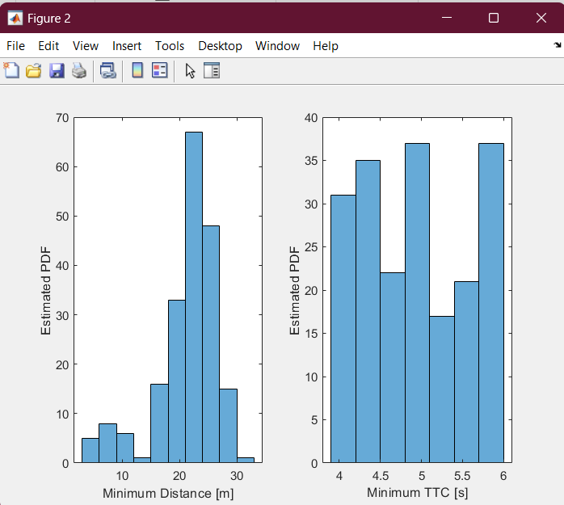
Data Analysis
A
B

Slide 12
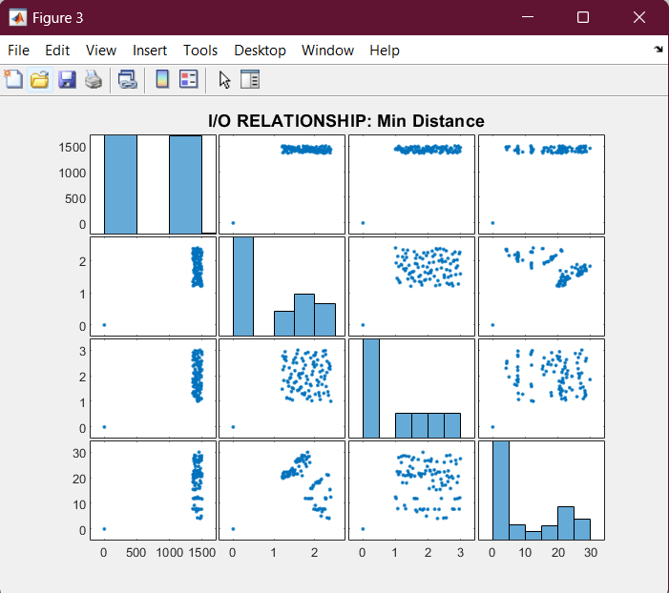
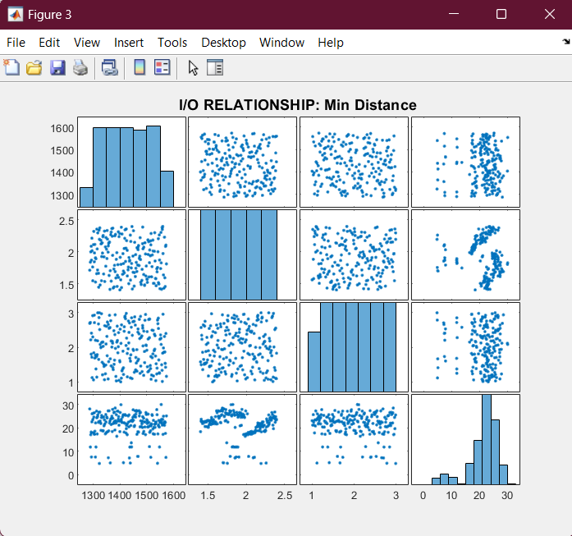
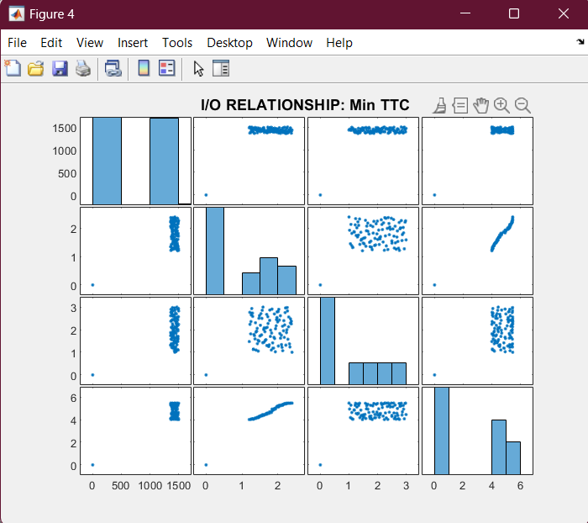
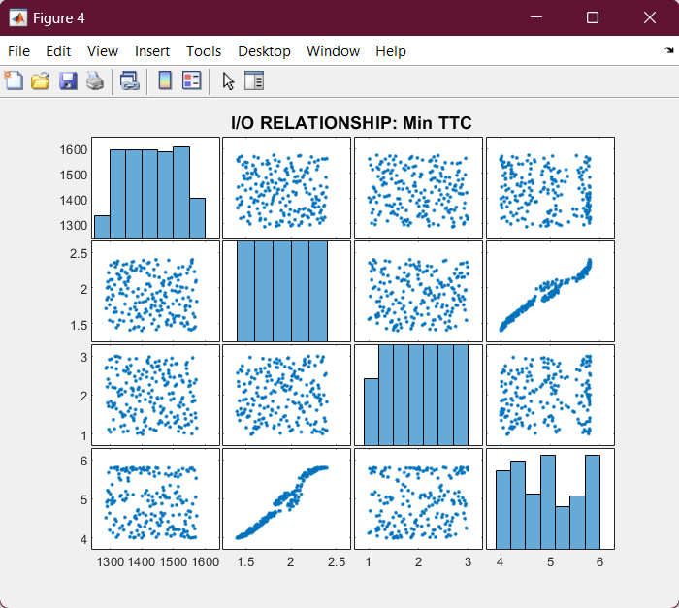
Correlation of the Min Distance and Min TTC
A
B

Slide 13
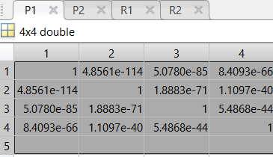
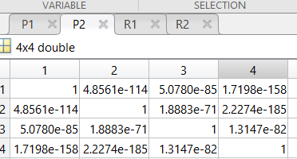
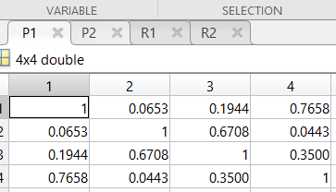
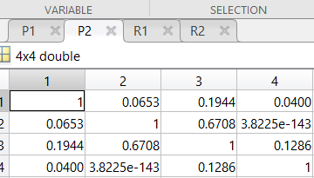
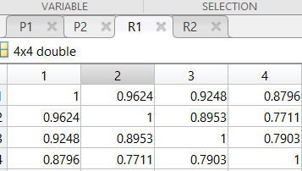
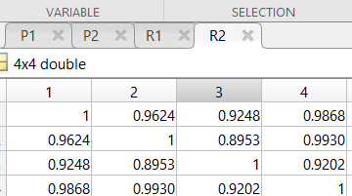
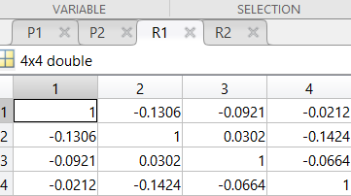
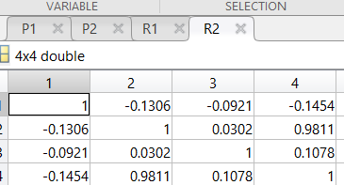
Correlation Analysis
A
B
P1
P2
P1
P2
R1
R2
R1
R2

Slide 14
Sampling in Example 2 - LHS Application
Specifics of LHS in Example 2: Latin Hypercube Sampling in Code 2 focuses on in-depth exploration of traffic dynamics and vehicle interaction parameters, adjusting the sampling resolution to capture more subtle effects and interactions.“
Objective of Advanced Sampling: The objective is to generate a highly diversified and statistically significant dataset that can validate the ACC (Adaptive Cruise Control) algorithms under varying but precisely defined traffic conditions.“
Impact and Benefits: This LHS application supports rigorous stress-testing of the system, ensuring robustness against a broader range of scenarios and significantly contributing to the overall safety and reliability of our autonomous driving technology.“
Number of Simulations: Model A: 200 Model B: 300

Slide 15
KPI of the Model
Key Performance Indicator (KPIs) are crucial metrics that help us evaluate the efficacy and safety of automated driving systems under a variety of simulated conditions. They are essential for quantifying system performance and guiding further improvements.
Listed KPIs and Their Importance
Minimum Distance: Measures the closest approach between the ego vehicle and the leader vehicle, indicating safety margins.
Time to Collision (TTC): Calculates the time remaining before a collision would occur if the current speed and distance are maintained, a critical measure of response adequacy.
Crash Rate: Percentage of simulation runs where the minimum distance falls below a critical threshold (e.g., 0.01 meters), indicating a potential collision.
Danger Rate: Percentage of instances where TTC is below a critical threshold (e.g., 0.5 seconds), signalling imminent risk.

Slide 16
KPI Analysis Outcomes
Analytical Approach:
Our analysis involves examining the simulation outputs to calculate the frequency and conditions under which each KPI threshold is breached. This approach enables us to identify patterns and potential weaknesses in the system’s performance.
Insights from KPIs:
Minimum Distance and TTC:
These indicators help pinpoint operational inefficiencies and areas where the control system might not react optimally to prevent close encounters or collisions.
Crash and Danger Rates:
High rates indicate potential vulnerabilities within the system, necessitating adjustments in control algorithms or parameter settings to enhance safety.
Implications for System Development
System Improvements:
By understanding which parameters frequently lead to unsafe conditions, we can refine our algorithms to better handle variable driving scenarios and improve overall vehicle safety.
Strategic Adjustments:
The analysis directs our focus toward parameters that significantly influence system behaviour, guiding targeted modifications to reduce crash and danger rates.

Slide 17
Thank You!

